Slide 1

Lesson 1 - Introduction to Authorization PDP GE
FIWARE Chapter: Security
FIWARE GE: Authorization PDP (current version: R5)
FIWARE GEri: AuthzForce (current version: 5.4.1)
FIWARE GE Owner: Cyril Dangerville, Thales Services
Notes:
Hello,
My name is Cyril Dangerville, from Thales Services. I am the Architect of the FIWARE Security Chapter, and I am going to give you the first lesson about one of the Generic Enablers in this chapter: the Authorization PDP. I also happen to be the owner of this Generic Enabler. This lesson gives you a brief introduction to the Authorization PDP as it is specified in FIWARE release 5. I am also the owner of its Reference Implementation, AuhtzForce, currently in release 5.4.1, which the latest version implementing the Authorization PDP specification as of today.

Slide 2
Goals of this lesson
Introduce the Authorization PDP Generic Enabler
Why do we need this GE?
What does it do?
How does it fit in FIWARE architecture?
Introduce the GE reference implementation (AuthzForce)
Give pointers for more info
Introduce next lessons

Slide 3
Why FIWARE needs this GE (1/2) … or why FIWARE needs Attribute-Based Access Control?
Need for flexible/granular access control in FIWARE use cases
Identity Management GE provides RBAC authorization but…
RBAC limitations:
Coarse-grained, two-dimensional (user roles, role permissions)
Lack of context (time of day, location, relationship between users…)
→ Role explosion → not scalable → not manageable
Limited separation of duties (static only)
Better model: ABAC (Attribute-Based Access Control)
Attributes: subject-related (role, department, org…), resource-related (type, owner…), action-related, etc.
Finer-grained, multi-dimensional, contextual
FIWARE needs ABAC
Authorization PDP GE = essential part of the ABAC architecture in FIWARE
Notes:
Lack of context:
“Due to the static nature of Role Based Access Control, RBAC is unable to model policies that depend on contextual details such as time-of-day, location, relationship between users, and so on“
Source: The Evolution of RBAC Models to Next-Generation ABAC: An Executive Summary, Axiomatics (2016)

Slide 4
Why FIWARE needs this GE (2/2) ABAC vs. RBAC
Role explosion example:
Roles in a bank: Teller, Supervisor, Branch director
Many bank agencies: Paris, London, Berlin
What about Teller in Paris, Teller in London, Teller in Berlin, Supervisor in Paris, Supervisor in London…? → 9 roles!
RBAC ☹ / ABAC ☺: Doctor-patient and patient-record relationships
Doctor may only access medical records of his/her own patients
If resource.type = ‘MEDICAL_RECORD’
AND action.id in {‘read’,’write’}
AND user.id = medical_record.doctor_id, then Permit
A patient may only access medical records about him/herself
If resource.type = ‘MEDICAL_RECORD’
AND action.id =‘read’
AND user.id = medical_record.patient_id, then Permit
RBAC ☹ / ABAC ☺: Dynamic separation of duties
User may approve purchase order only if not assigned to him/herself (approver ≠ assignee)
ABAC-style (deny unless permit):
If resource.type = ‘PURCHASE_ORDER’
AND action.id = ‘approve’
AND user.id ≠ purchase_order.assignee, then Permit

Slide 5
The GE in FIWARE Architecture (1/2) FIWARE ABAC Architecture – Generic Enablers
FIWARE’s ABAC architecture consists of:
PDP (Policy Decision Point) → Authorization PDP GE
Loads authorization policies from a Policy Repository
Evaluates authorization decision requests – from PEPs - against authorization policies and returns authorization decisions (Permit/Deny) as a result
PAP (Policy Administration Point) → Authorization PDP GE
Manages authorization policies in a Policy Repository shared with the PDP
Limited GUI provided by the Identity Management GE’s developer portal
PEP (Policy Enforcement Point) → PEP Proxy Generic Enabler instance
Protects a target resource by intercepting access requests and enforcing security rules on them, including:
Authentication → token validation request to the Identity Management GE
Authorization → authorization decision request to Authorization PDP GE
There may be as many PEPs as resource access points, i.e. typically REST services in FIWARE
PIP (Policy Information Point) → Identity Management GE
Provides extra info (attributes) to the access request context, e.g. user roles
Interactions
IdM → PAP API of Authorization PDP
PEP → IdM for getting extra authorization attributes (user ID, role…)
PEPs → PDP API of Authorization PDP
Notes:
Now that you understand the need for ABAC, let’s see how it is implemented in FIWARE architecture

Slide 6
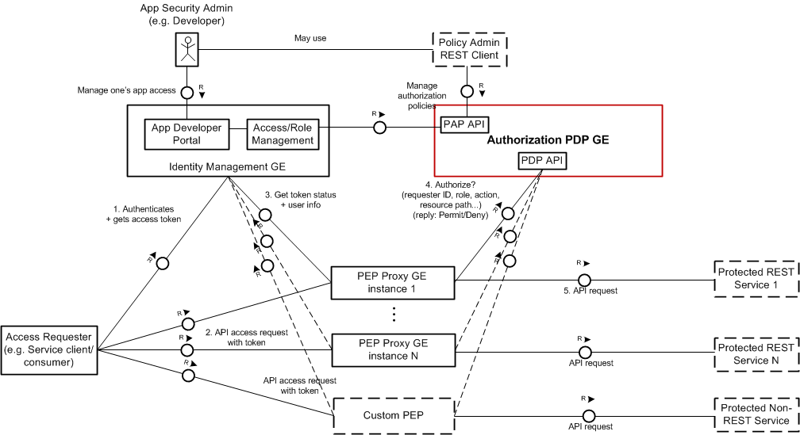
The GE in FIWARE Architecture (2/2) FIWARE ABAC Architecture - Big picture

Slide 7
Authorization PDP GE Specification
FIWARE Open Spec document (link)
Multi-tenant RESTful API for…
ABAC PDP (Policy Decision Point)
ABAC PAP (Policy Administration Point)
Based on OASIS XACML as standard ABAC policy language and PDP request-response protocol
1 PDP/PAP (+ policy repository) per domain
API Details→ Lesson 2
GEri (reference implementation): AuthzForce → Lesson 3

Slide 8
Where to go next?
Lesson 2: Introduction to Authorization PDP GE’s API
Lesson 3: Introduction to the GEri AuthzForce
Everything you need to know about the GE & GEri is on the FIWARE catalogue (link)

Slide 9
Q & A
Thanks for your attention ☺

